Slide 1





VITISH 2024 (SIH Internal Hackathon)
Problem Statement ID- SIH1600
Problem Statement Title- Student Innovation
Theme- Smart Automation
PS Category- Software
Team ID- VIT469
Team Name-

Slide 2
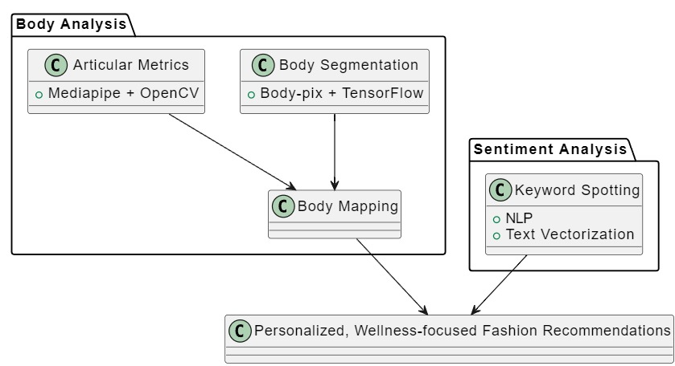
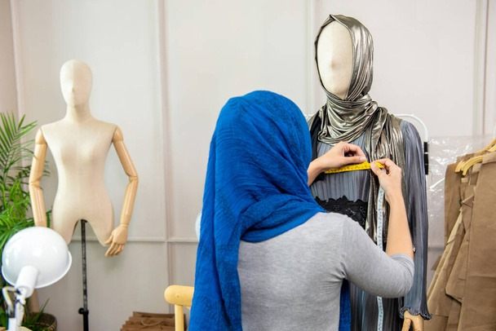
TrendTuner+ : Intelligent Fashion Tailoring and Recommendation System
Problem Statement:
Fit and Style Challenges: Consumers often struggle to find clothing that matches their unique body measurements and personal style preferences.
Time-Consuming Shopping: Traditional shopping methods can be inefficient and require significant time investment.
Limited Personalization: The lack of tailored options in stores can result in dissatisfaction with fit and style.
Custom Tailoring: Clothing is designed and fitted precisely to the user's unique measurements.
Proposed Solution:
TrendTuner+ integrates AI body scanning to create custom-fit clothing and utilizes a recommendation model to suggest outfits based on user preferences.
Novelty:
Tailored Fittings: Clothes are custom-fitted according to the user's body measurements.
Performance-Based Recommendations: Clothing suggestions are made based on the user's performance data.

Slide 3
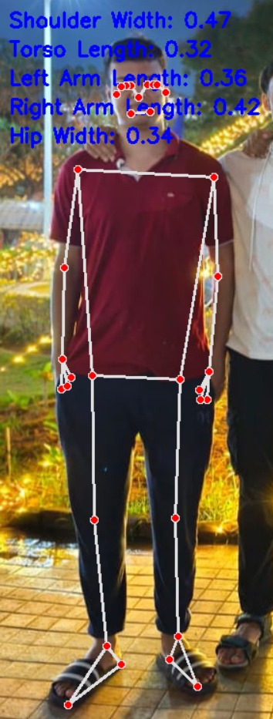
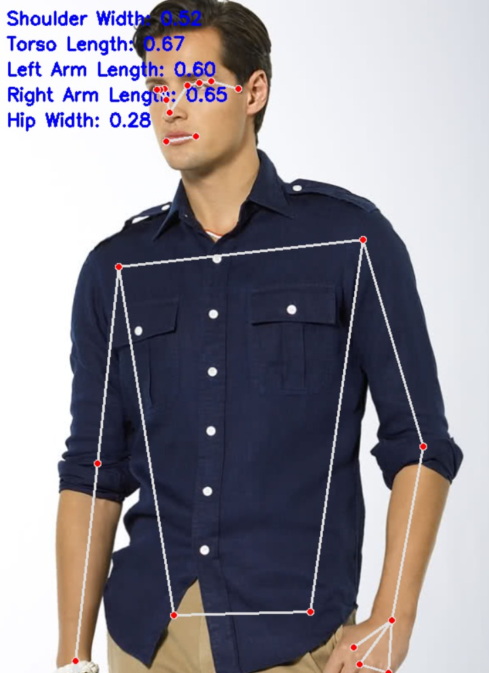
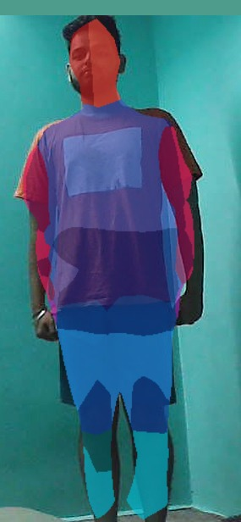
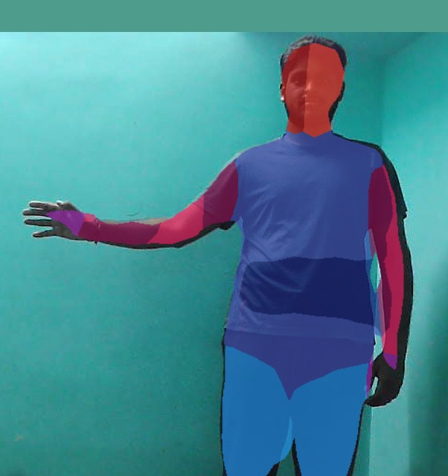
TECHNICAL APPROACH
Body joint detection
MediaPipe and OpenCV integration enables real-time human pose analysis.
MediaPipe's pose estimation model detects various body joints.
OpenCV is used to visualize joints in the video stream.
Applications include fitness tracking, gesture recognition, and interactive gaming.
Body segmentation
BodyPix segments the body in real-time using TensorFlow.
Background elimination is achieved through machine learning with BodyPix.
TensorFlow handles model deployment.
HTML, CSS, and JavaScript enable interactive visualization and manipulation on the front-end.
Processing & Analysis

Slide 4
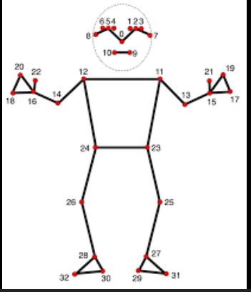
FEASIBILITY AND VIABILITY
Feasibility Analysis:
A. Technical:
AI-powered body scanning and a personalized recommendation system for users
B. Operational:
Gradual integration with retail apps, starting with core features like body scanning.
Potential Challenges and Risks:
A. Technical:
Ensuring accuracy in body scanning and recommendation system.
B. Privacy and Security:
Managing and storing images present several security concerns.
C. User Adoption:
Users may resist linking health data to fashion.
Strategies for Overcoming Challenges:
A. Accuracy:
Improve scanning algorithms and recommendation System.
B. Privacy:
Implement strong encryption and user-controlled data sharing.

Slide 5
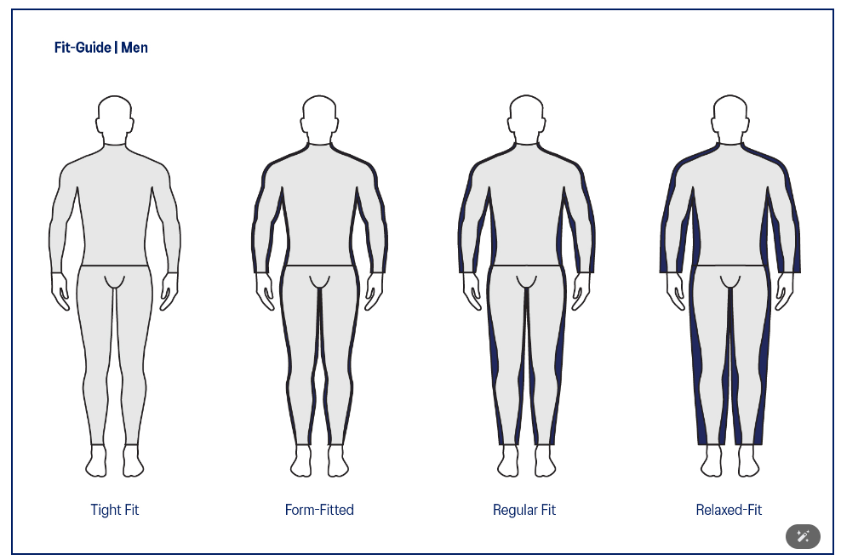
IMPACT AND BENEFITS
Potential Impact on the Target Audience
A. Enhanced Personalization:
Users receive tailored clothing recommendations based on their unique measurements and style preferences, leading to a more satisfying shopping experience.
B. Improved Fit and Comfort:
By using accurate body measurements, the model reduces the likelihood of ill-fitting clothes, enhancing comfort and confidence in the wearer.
C. Reduced Return Rates:
By ensuring better fit and alignment with personal style, the model can significantly lower return rates, benefiting both consumers and retailers.
D. Confidence:
Custom-fit recommendations boost confidence and ensure a good fit.
E. Increased Accessibility:
The technology can help individuals who struggle to find clothes that fit well, including those with unique body shapes or sizes, making fashion more inclusive.
F. Sustainable Fashion Practices:
By reducing returns and promoting well-fitted clothing, the model can contribute to more sustainable fashion consumption patterns.
Benefits
A. Social:
Enhances self-expression and confidence.
Inclusive fashion with private customization options.
B. Economic:
Reduces costs from ill-fitting purchases and increases retailer sales.

Slide 6
RESEARCH AND REFERENCES
Shukla, R. (2020, April 7). Keywords Extraction and Sentiment Analysis using Automatic Speech Recognition. arXiv.org. https://arxiv.org/abs/2004.04099
The paper explores integrating Automatic Speech Recognition (ASR) with sentiment analysis to convert spoken language into text and analyze opinions. It compares various toolkits for speech-to-text conversion and examines methods for extracting sentiment attributes and keywords from the transcribed text.
N. D’Apuzzo, “3D body scanning technology for fashion and apparel industry,” SPIE Proceedings, vol. 6491. SPIE, p. 64910O, Jan. 28, 2007. doi: 10.1117/12.703785.
The paper reviews 3D body scanning technologies in fashion, detailing their transition from military to commercial use and comparing different scanning methods. It highlights the potential for increased adoption due to reduced costs.
Kim, J. W., Choi, J. Y., Ha, E. J., & Choi, J. H. (2023). Human Pose Estimation Using MediaPipe Pose and Optimization Method Based on a Humanoid Model. Applied Sciences, 13(4), 2700. https://doi.org/10.3390/app13042700
The paper presents a 3D pose estimation method that combines 2D pose estimation with optimization to address depth ambiguity. It achieves real-time performance and accurate pose estimation with a mean joint coordinate difference of 0.097 meters.

